Slide 1
Create Spend Authorization in Workday for Booking Travel
This deck will teach you how to create a spend authorization for travel purchases
Notes:
Job Aid: https://emersonadminandfinance.zendesk.com/hc/en-us/article_attachments/360037106312/Create_Spend_Authorization_for_Pre-Trip_Approval_-_v3.docx
Health and Safety is the largest issue. We absolutely want to encourage all travel, including FDF travel, to be booked through the Travel Collaborative/Concur. We want to know where our people are. If they don't use it, then we need to define the process for them to notify Alan to add them to the tracking system. For those that do, we need to see if giving Alan a report is sufficient to register them in the tracking system.
Faculty Development Funds are guaranteed and as a result, do not need to be encumbered by a spend authorization. However, all other travel requests, including funds given to faculty by a dean (not FDF), for example, do need a spend authorization. If it's a faculty member using deans funds, the dean should be the approver before Paul Dworkis. If it's a staff person, their VP needs to approve before Paul.

Slide 2
Create Spend Authorization in Workday
To begin, select the Expenses application on your Workday homepage
Under the Actions menu, select Create Spend Authorization
and fill out the required fields (including the business purpose)
Under Spend Authorization Details: Fill out the following fields
  Reimbursement Payment Type: Reimbursements will be made by direct deposit. (If you have not provided your banking information, use the Add Direct Deposit job aid to learn how to set this up before proceeding.)
  Justification: Indicate the purpose and benefit of these items/trip.

Slide 3
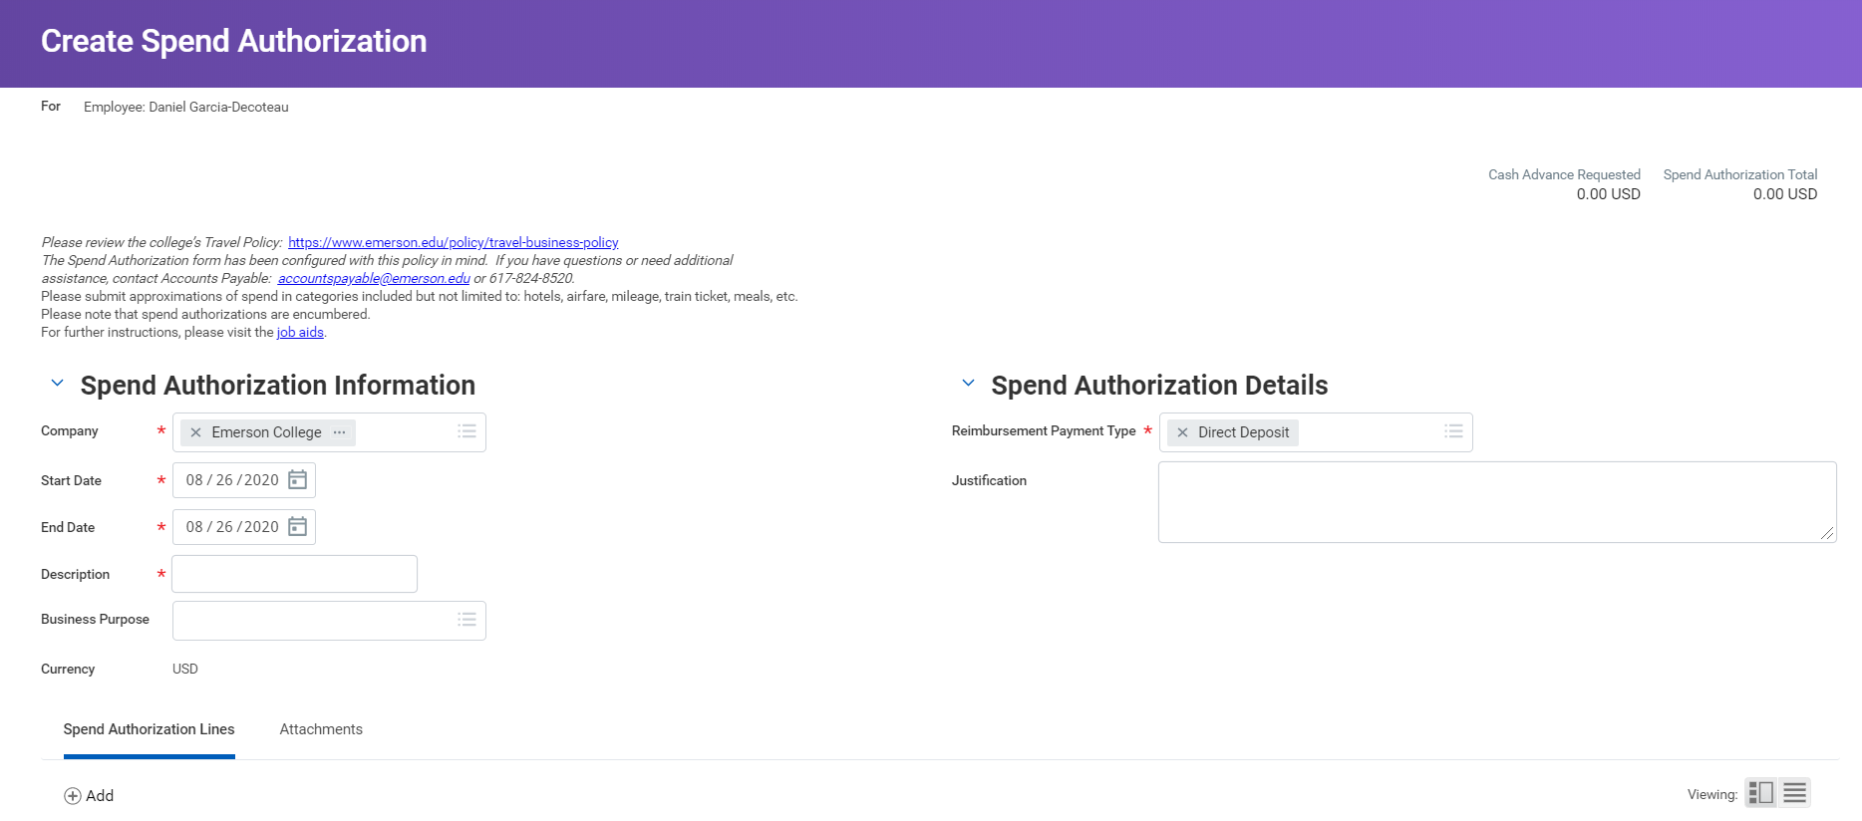
Create Spend Authorization Task in Workday
Notes:
Business Purpose is also REQUIRED

Slide 4
Create Spend Authorization in Workday
Next, click the Add Row icon to add line items
For each spend authorization line item, fill out all the required fields
  Expense Item: Select the appropriate item type from the list
  Quantity: Enter the number for the expense, if more than 1
  Per Unit Amount: Enter the cost per item
  Total Amount: Defaults from the Per Unit Amount multiplied by the Quantity
  Memo: Enter a brief description of the item
  Cash Advance Requested: Check this box if requesting a cash advance
  Cost Center: Defaults based on your department
  Program: Defaults, but it is editable
  Fund: Defaults, but it is editable
  Additional Worktags: If this item corresponds to a Grant or Project
Once complete, please submit for approval
Notes:
Job Aid - https://emersonadminandfinance.zendesk.com/hc/en-us/article_attachments/360037106312/Create_Spend_Authorization_for_Pre-Trip_Approval_-_v3.docx

Slide 5
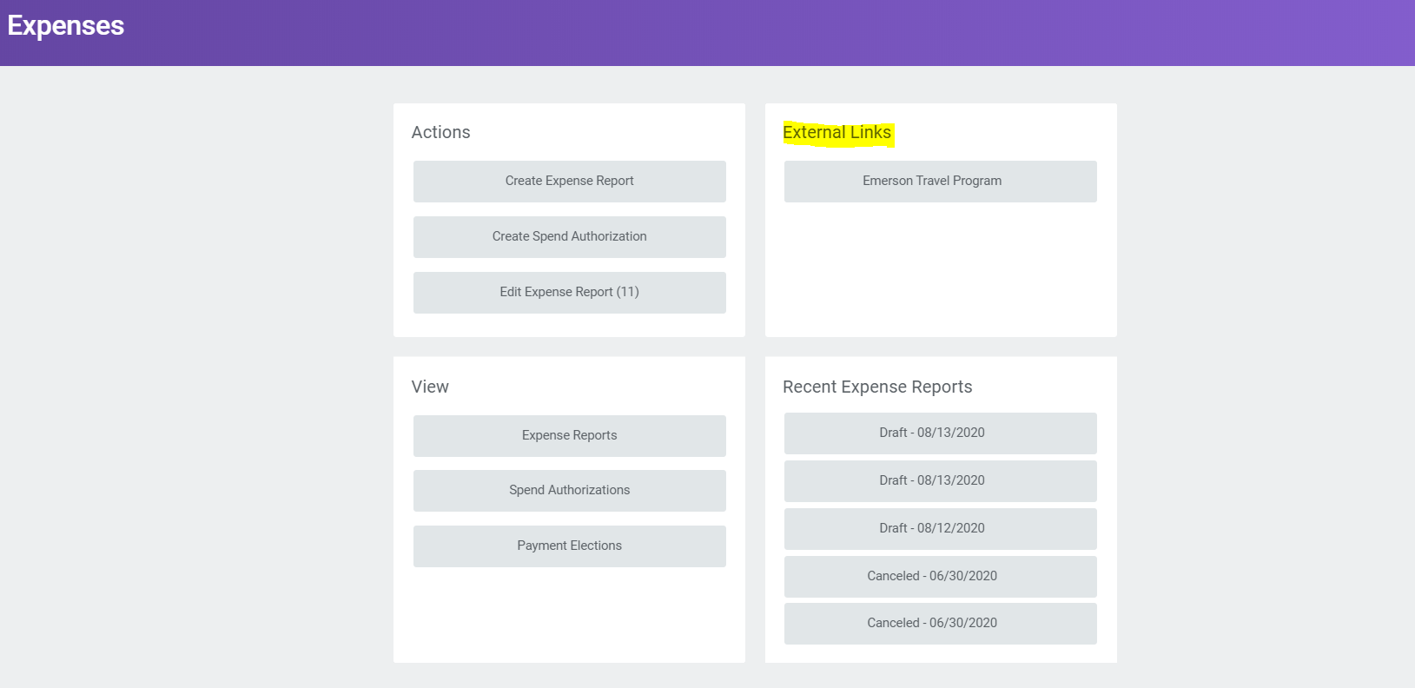
SAP Concur – Spend Authorization Number
Directions
Once approved, you can proceed to booking your travel.
In Workday, click on the Expenses worklet and select the Emerson Travel Program button.
Sign in and book your trip, as normal. If you need assistance, please email purchasing@emerson.edu

Slide 6
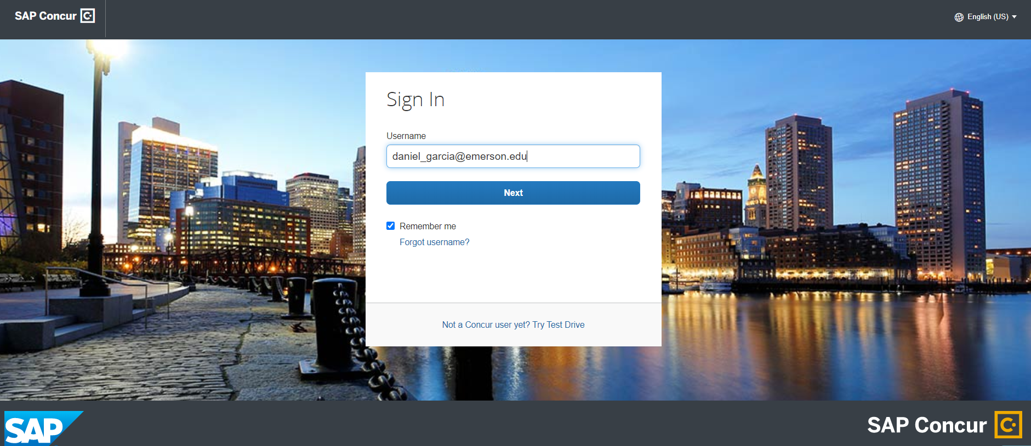
SAP Concur – Spend Authorization Number

Slide 7
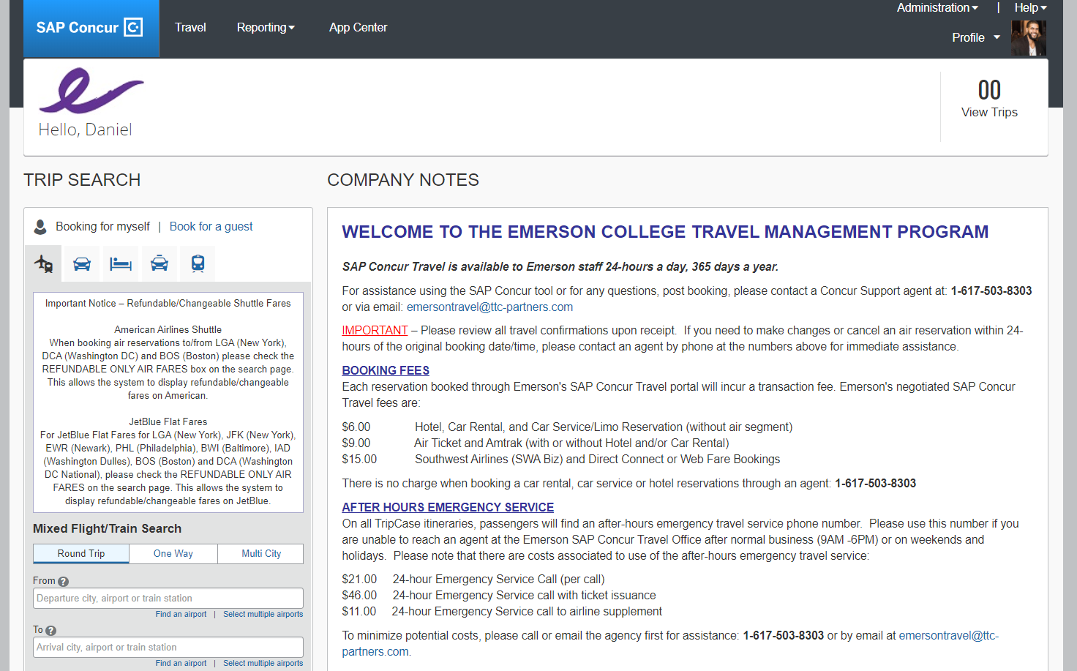
SAP Concur – Spend Authorization Number

Slide 8
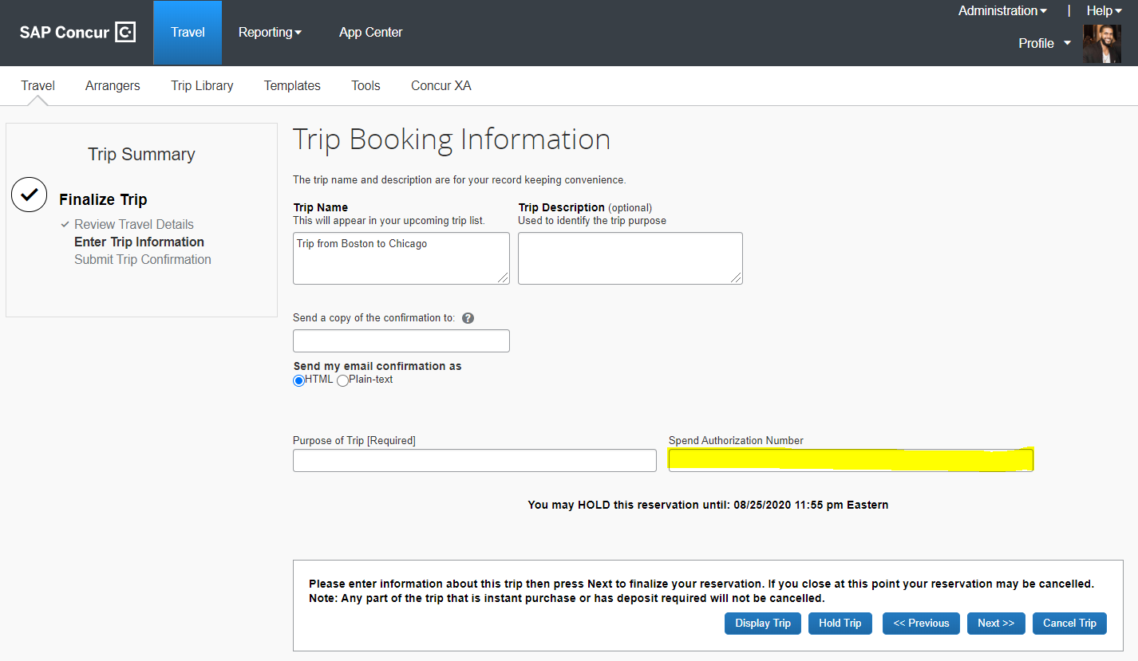
SAP Concur – Spend Authorization Number
Directions
On the final checkout page, you will need to add the spend authorization number acquired in Workday
You should acquire this prior to booking travel via the Create Spend Authorization task in Workday
  AUTH-XXXXXX

Slide 9
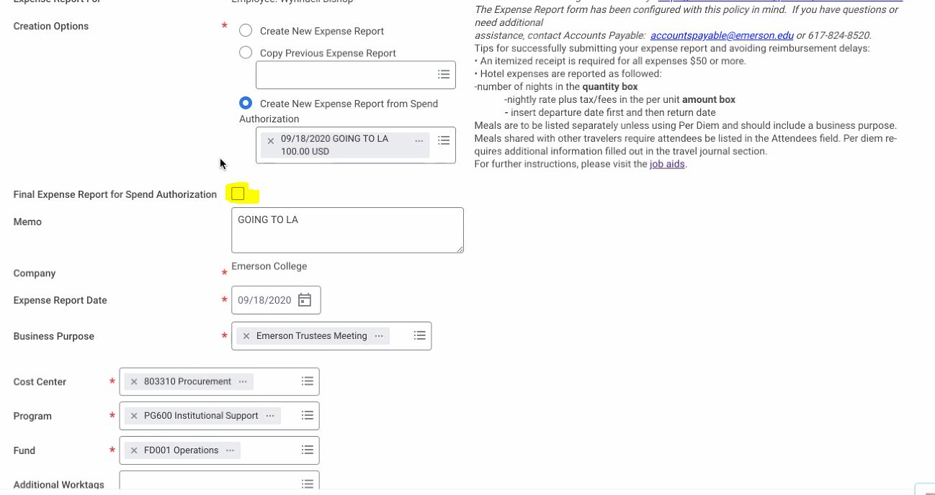
SAP Concur – Spend Authorization Number – Reconciliation
Notes:
Make sure to check the final expense report for Spend Authorization (SA) to close out the SA, once all the dollars are used.

