Slide 1
Excel Tips and Techniques
By Business Intelligence and the Controller’s Office
Our tips and techniques for fast number crunching and data analysis

Slide 2
Session Objectives
The objective of this session is to bring our favorite features and functions to your attention.
We will demonstrate how we use Excel to analyze data and crunch numbers.
Note: This is based on Excel 2016 for Windows. Navigation in other versions may vary slightly but the formulas and concepts are the same.
Very useful, detailed information for Excel can also be found using the search function at https://support.office.com/en-IN/Excel

Slide 3
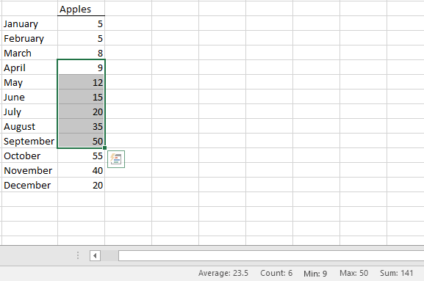
Quick Tip #1 Auto Calculate
Use Excel “AutoCalculate” to quickly sum and count cells
Right Click here to bring up option box and set displayed functions

Slide 4
Quick Tip #2 Navigation and Simple Formulas
Navigation
CTRL+Arrows (Moves cursor to last cell in that direction)
SHIFT+Arrows (Selects current cell and the cell in that direction)
CTRL+SHIFT+Arrows (Selects current cell and all cells in that direction)
CTRL+HOME (Places cursor in top left cell)
CTRL+END (Places cursor in cell furthest right and bottom with data in it)
CTRL+SHIFT+HOME/END (Selects all cells between cursor and top left/furthest right and bottom cells with data in it)
Simple Functions
CTRL+X (Cut cells)
CTRL+C (Copy cells)
CTRL+V (Paste cells)
CTRL+F (Find, Find and Replace)

Slide 5
Quick Tip #2 Navigation and Simple Formulas (cont.)
=sum(cell range or amounts) – Will sum the data/cells included
=max(range or values) – Will return the highest amount in the range, including latest date if dates are entered
=min(range or values) – Will return the lowest amount in the range, including earliest date if dates are entered
=left/right/mid(cell) – Will return the number of characters specified within a cell
=concatenate(cell1,cell2,etc.) – Will combine the text within the specified cells into one cell
=rand() – Will generate a random number between 0 and 1
=ifna(cell) – Will allow you to change a cell value if the argument entered returns “#N/A”
=(cell/value)=(cell/value) – Will indicate whether one cell or value equals another (if true, will say “TRUE”, if false, will say “FALSE”
=subtotal(function,range) - Will create a subtotal that will sum/count/average the range selected)

Slide 6
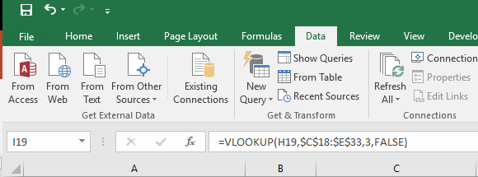
Quick Tip #3 Absolute References
Working with Formulas “Absolute Reference” vs. “Relative Reference”
Press F4 to cycle through Cell Reference options. NOTE: “$” sets the reference Auto Adjust Row and Column Range =SUM(C2:E2) Lock Row and Column Range =SUM($C$2:$E$2) Lock Row Range =SUM(C$2:E$2) Lock Column Range =SUM($C2:$E2)

Slide 7
Quick Tip #4 Excel VLOOKUP Function
Use this function to LOOKUP data from other Excel Spreadsheets and return values associated with them.
Click here to bring up option box, search for and select VLOOKUP

Slide 8
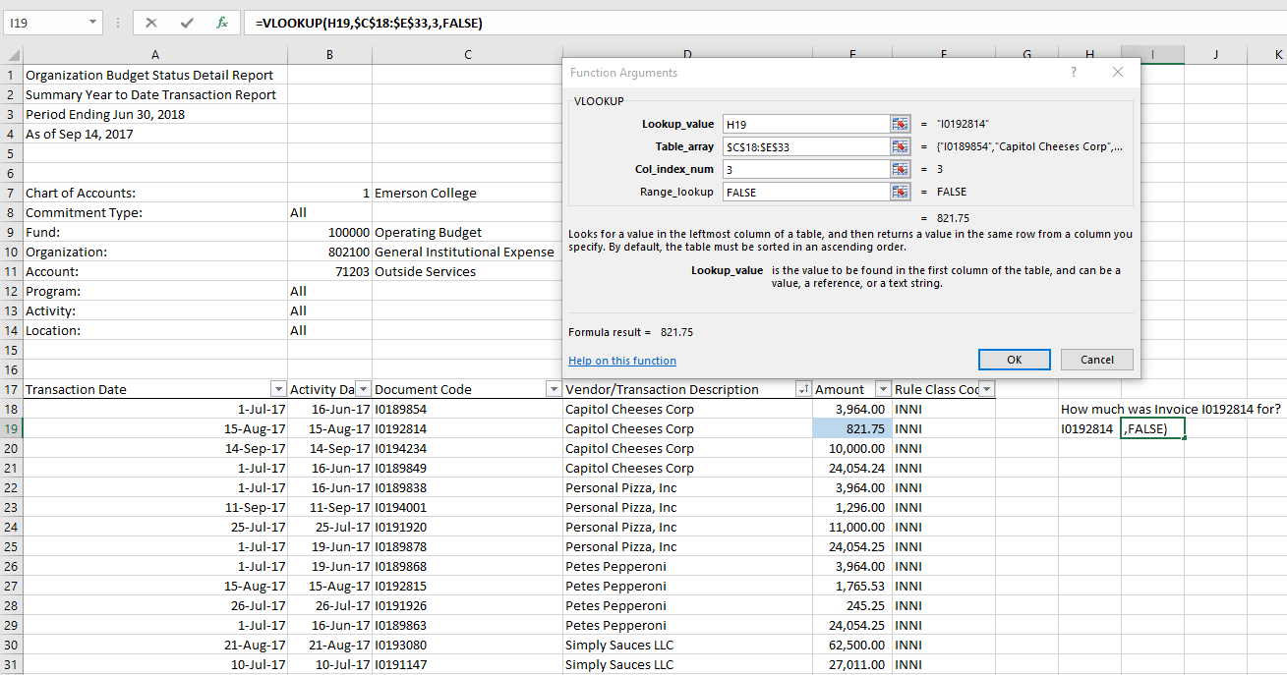
Quick Tip #4 VLOOKUP (cont.)
Formula: =vlookup(lookup_value,table_array,col_index_num,range_lookup)
Lookup_value: The unique identifying number/characteristic that we are trying to return a value for, which needs to be located in the column furthest to the left.
Table_array: The area containing the data we are looking for.
Col_index_num: The column number within the table where the data we want is entered.
Range_lookup: Indicates whether or not we want an exact match for our value being researched (“False”) or the closest to what we’ve searched for (“True”). In nearly all instances, this will be “False”.

Slide 9
Quick Tip #4 VLOOKUP (cont.)
Formula: =vlookup(lookup_value,table_array,col_index_num,range_lookup)
Example: We want to know how much Invoice I0192814 was for.
Lookup_value: Selected cell H19 (contains “I0192814”)
Table_array: Selected cells C18 through E33 because that’s where our data is located
Col_index_num: Selected “3” because we want to return the data in the third column
Range_lookup: Selected “False” because we want an exact match
Result: 821.75

Slide 10
Quick Tip #4 VLOOKUP (cont.)
VLOOKUP Troubleshooting – Common Errors and Things to Remember:
You will need to ensure the formatting of the “lookup_value” is the same as the first column in the table. If our cell H19 was formatted as a number, and the first column of the table was formatted as text, we may get a result of “#N/A”.
The “lookup_value” needs to be a unique number and can’t be repeated multiple times in the data set. If there were multiple entries for “Capital Cheeses Corp” in our example, only the first result in the data set would be returned.
A best practice for entering the “table_array” is to use absolute references (type $C$18:$E$33 rather than C18:E33) because if the formula is copied/pasted to any other cells, the “table_array” will change as well, and the data you are looking for may not be picked up.
HLOOKUP can also be used for data arranged horizontally, rather than vertically. The layout of the two “LOOKUP” formulas are similar.

Slide 11
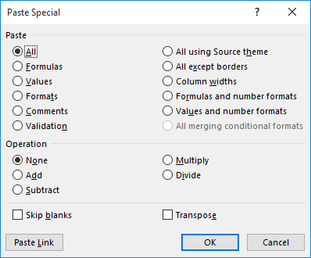
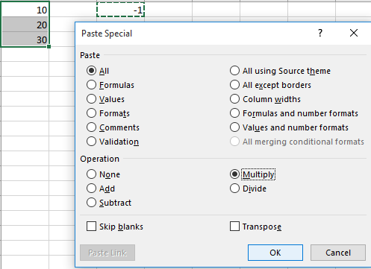
Quick Tip #5 Paste Special
Use Excel’s HOME > CLIPBOARD > PASTE SPECIAL >
Values: Replace formulas with returned results
Formats: Allows you to paste in formatting from one cell or set of cells to another
Formulas: Pastes the formula of a copied cell, not the result
Multiply: Will replace the highlighted cells with the product of the copied cell and the previous value in the selected cell

Slide 12
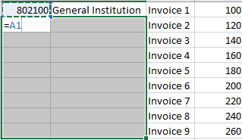
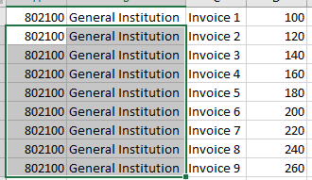
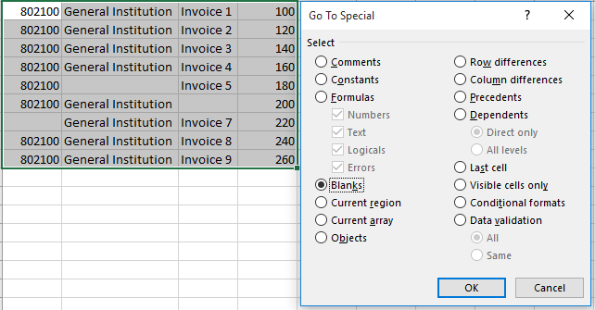
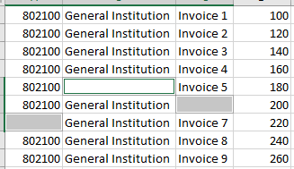
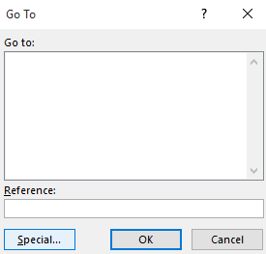
Quick Tip #5 Paste Special (cont.)
Pasting down values from above:
Highlight the cells you would like to paste values down into
Enter the cell reference that you would like to paste from
Press CTRL+ENTER, which will paste the references down
CTRL+G > “Special” with cells selected allows you to select specified types cells within the highlighted area

Slide 13
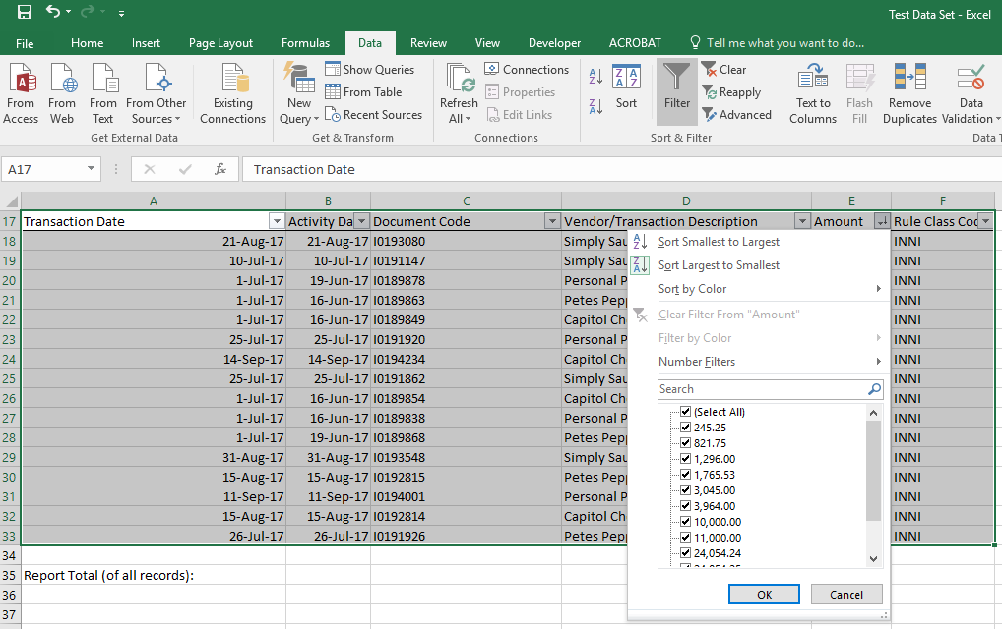
Quick Tip #6 Filters
Add an AutoSum after you filter,
not before!
This is a great tool for analyzing data.
Highlight all your data and go to DATA > SORT & FILTER > FILTER
Filters can be added as needed. Filters may be applied to multiple columns at once.

Slide 14
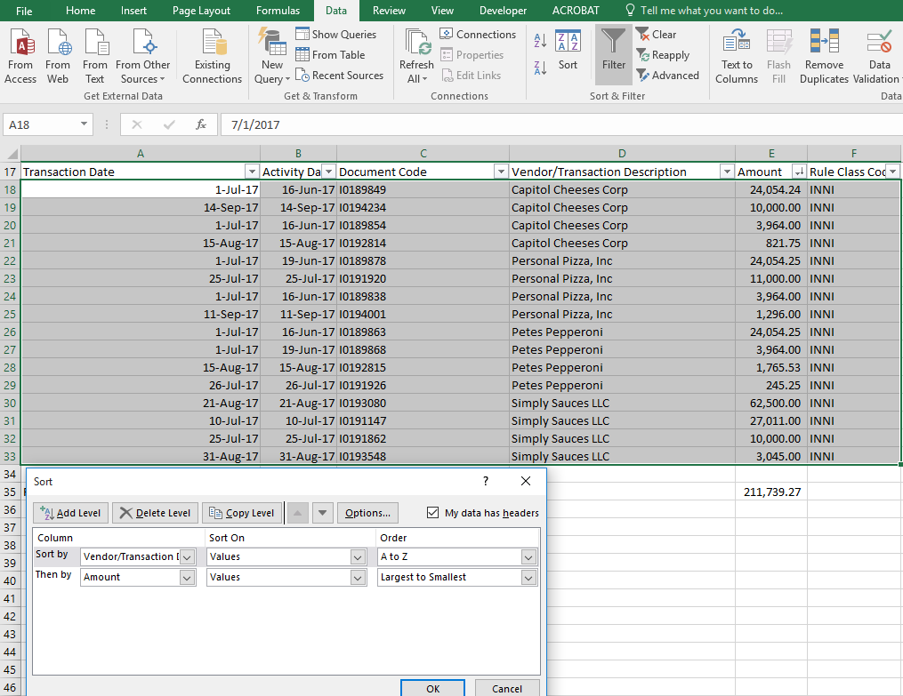
Quick Tip #7 Sorts
This is a great tool for analyzing data.
Highlight all your data and go to DATA > SORT & FILTER > SORT
Sorts can be applied to multiple aspects of data in a set hierarchy. The example at right will first sort the data by vendor name A to Z, then by transaction amount high to low within that vendor name.

Slide 15
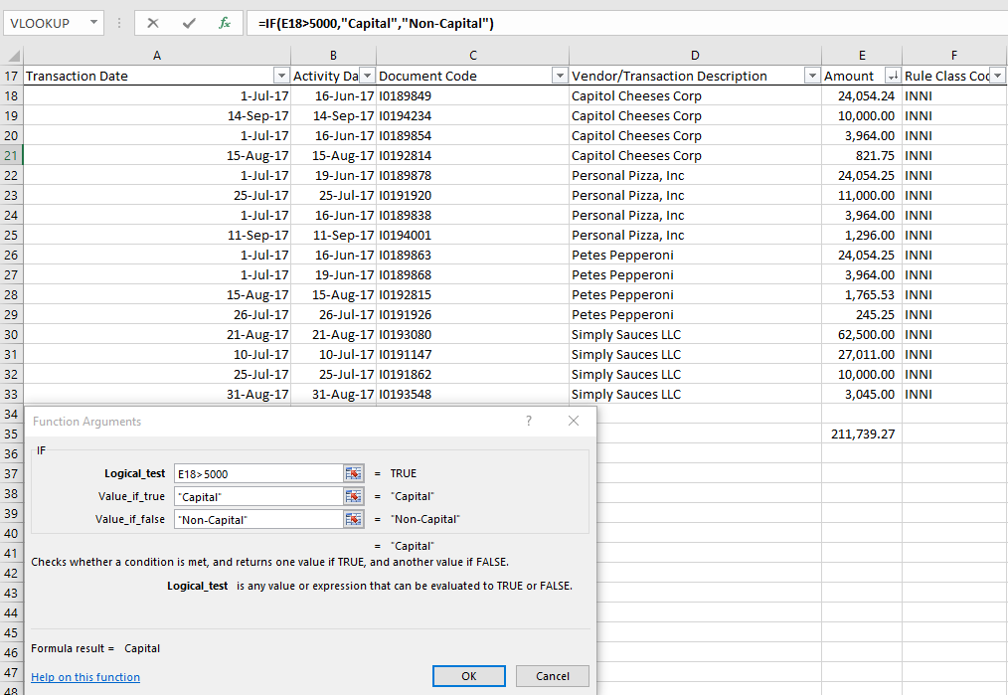
Quick Tip #8 IF Statements
Use this function to add more meaning to your data. Create your own data values.
=if(logic_test,value_if_true,value_if_false)
Logical Test: Mathematical formula that will be either true or false
Value if True: The value to be returned if the logical test is true
Value if False: The value to be returned if the logical test is false

Slide 16
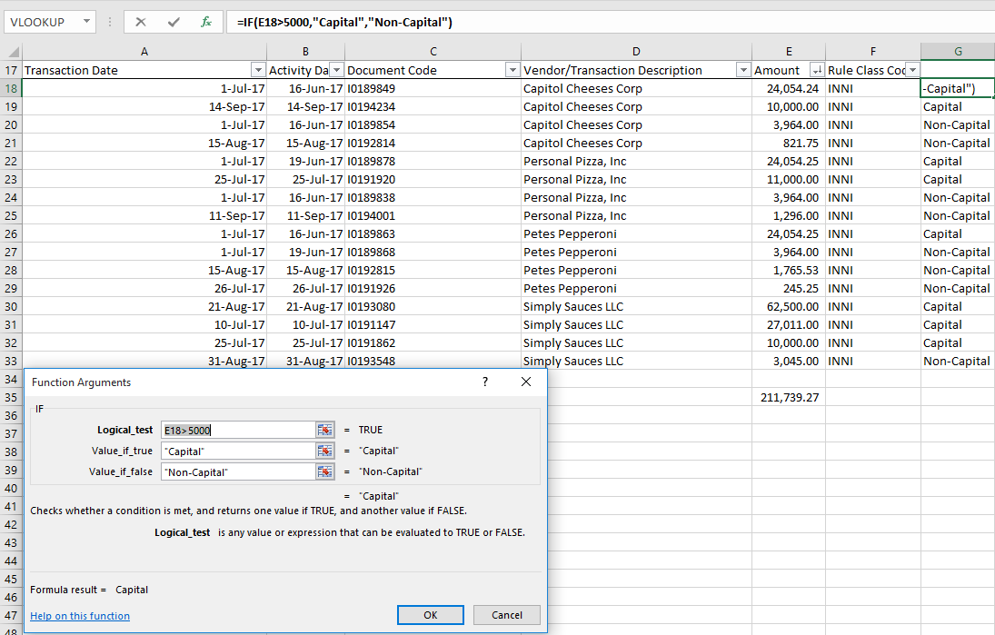
Quick Tip #8 IF Statements (cont.)
Example: Would any of the items I purchased be considered a capital expenditure (over $5,000)?
Logical Test: Amount>$5,000?
Value if True: “Capital”
Value if False: “Non-Capital”

Slide 17
Quick Tip #8 IF Statements (cont.)
Things to remember:
The logical test can be a formula itself: =if(or(E18,E19,E20,E21)>5000, “Yes”, “No”) in my previous example would tell me if any purchases from Capitol Cheeses Corp met the capital threshold
If you want text to be returned in the Value if true/false, it needs to be in quotes.
Remember that there needs to be the same number of open parentheses as closed parentheses in the formula for it to work correctly.
Math Refresher: Excel follows the set PEMDAS order of operations (Parentheses, Exponents, Multiplication, Division, Addition, Subtraction in that order)

Slide 18
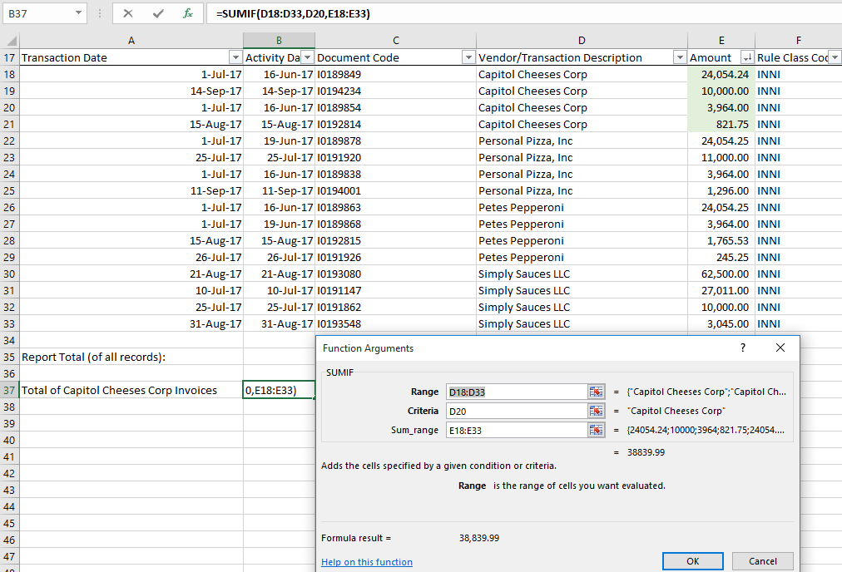
Quick Tip #9 SUMIF Statement
Use this function to add sum values meeting a certain criteria
=sumif(range,criteria,sum_range)
Range: Range of cells that could contain the desired criteria
Criteria: What the cell in the range needs to equal to be considered and summed
Sum_range: The associated cells that should be summed if the defined criteria is met

Slide 19
Quick Tip #9 SUMIF Statement (cont.)
Example: What is the total of all invoices from Capitol Cheeses Corp?
Range: Vendor description column D18:D33
Criteria: Capitol Cheeses Corp, D20 (could have also entered “Capital Cheeses Corp” in quotes for this)
Sum_range: Where the invoice amounts are stored, E18:E33
Result: 38,839.99

Slide 20
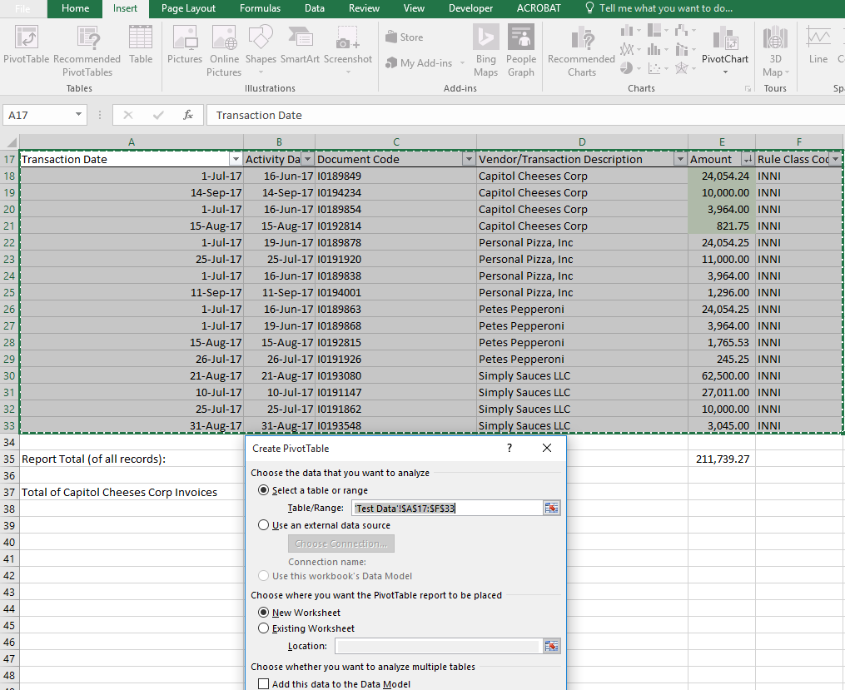
Quick Tip #10 PIVOT TABLES
Pivot tables can be used to sort, filter, and analyze data.
Select all of your data, including column headings (required), and go to INSERT > PIVOT TABLE
Tables can be added in a new worksheet, or at a specified location in an existing worksheet

Slide 21
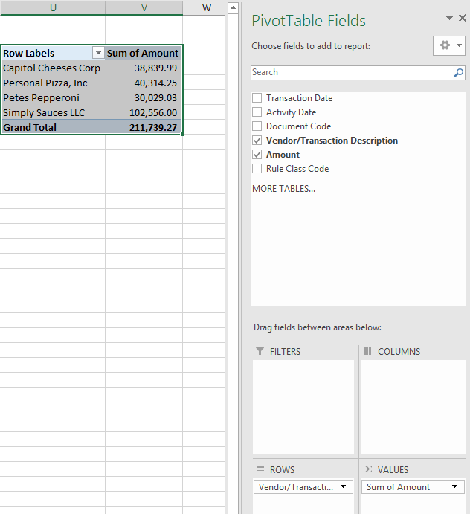
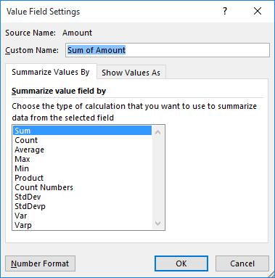
Quick Tip #10 PIVOT TABLES (cont.)
Based on column heading, criteria can be added as either a row, column, value, or filter
Multiple items can be included as rows, columns, or filters, which provides additional detail
The value field can do a number of functions as shown below, and can be changed by clicking the twist/dropdown on the right side of the criteria
Including criteria in “Column” allows for three-dimensional reporting. For example, this could show expenses by Org, broken out to show the expenses by fund number. Further filters could be added for things like GL account.

Slide 22
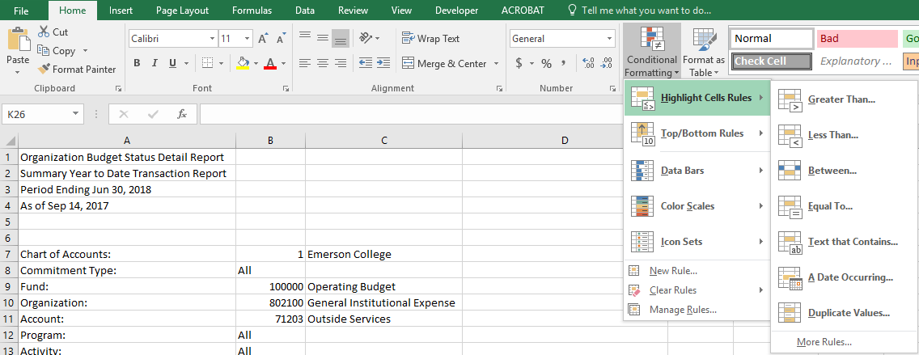
Quick Tip #11 Formatting and Other
Conditional Formatting:
Allows for formatting based on different cell attributes
Remove Duplicates:
Will remove duplicate data entries (may be useful when aggregating data

Slide 23
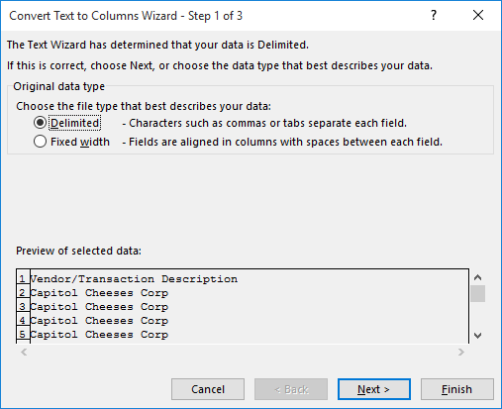
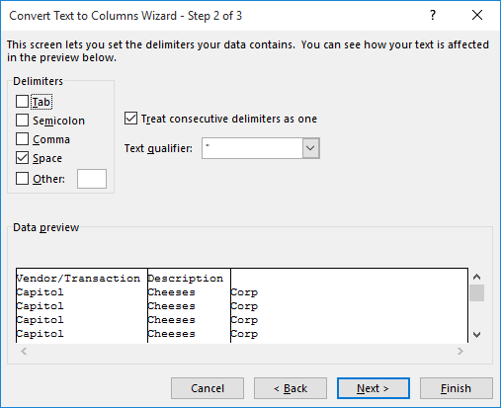
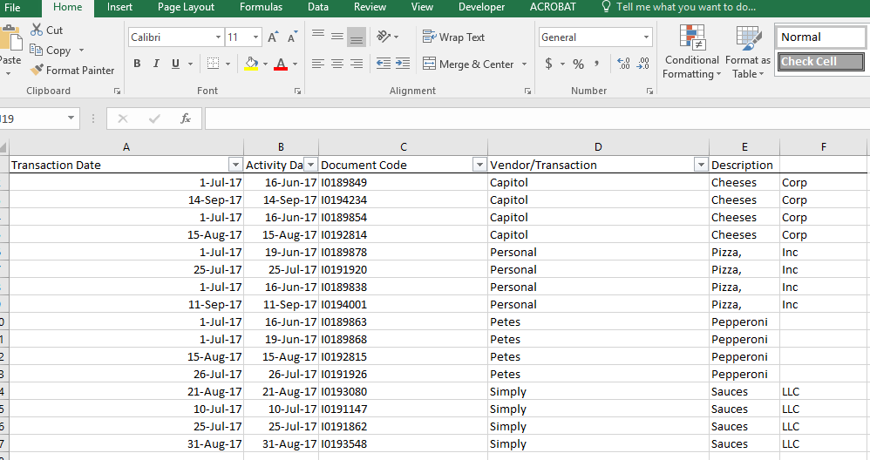
Quick Tip #11 Formatting and Other (cont.)
Text to Columns:
Useful when analyzing data and need to break a single cell into multiple columns
Can break into multiple columns using a fixed column width or “delimited” (identifying a specific character where Excel then knows to move the following data to the next column)

Slide 24
Questions?
Thank you for attending!

